Slide 1
ON THΞ HUNT IN THΞ DΔRK
INTRODUCTION TO THREAT INTELLIGENCE AND THREAT HUNTING ON THE DARK WEB
Notes:
WELCOME TO “NEXT GEN PEN TEST - INTRODUCTION TO RED TEAMING AND ADVERSARY EMULATION”
THE NEXT HALF-HOUR IS GOING TO BE A HIGH LEVEL OVERVIEW OF A QUITE TECHNICAL NICHE OF INFORMATION SECURITY
WE WILL HAVE A LOOK AT HOW - NOWADAYS - THE BAD GUYS TAKE ADVANTAGE OF THE WEB TO DO THEIR THING AND WIL WILL TRY TO COME UP ON THE OTHER SIDE WITH A STRATEGY ON HOW TO DEFEND FROM THEM

Slide 2
AGENDA
Level-setting
The Process
Resources
Gimme-the-demooo
Notes:
SLIDES WILL BE SHARED AFTER THIS TALK, INCLUDING SPEAKER’S NOTES (BTW A BIG SHOUT OUT TO BLABLA FOR SUPPORTING THE IDEA OF THIS BLABLABLA AND TO BLABLABLABLA FOR HIS/HER HELP IN SETTING IT UP!)
EARLY WARNING: HOPE YOU ALL HAVE NOTHING AGAINST MEME’S…
LASTLY, LET’S KEEP THIS INTERACTIVE! DON’T WAIT FOR THE END TO ASK QUESTIONS

Slide 3
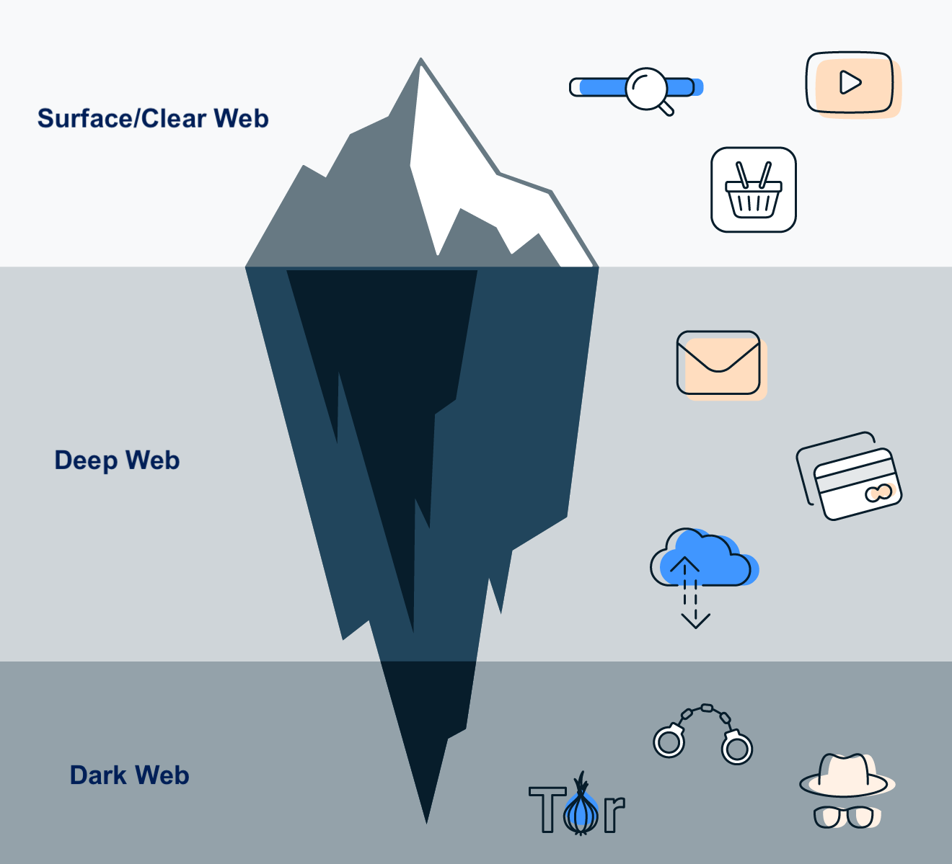
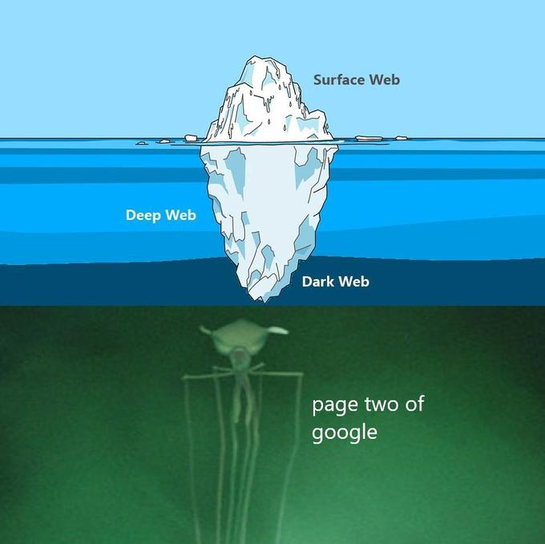
LEVEL-SETTING
Notes:
SLIDES WILL BE SHARED AFTER THIS TALK, INCLUDING SPEAKER’S NOTES (BTW A BIG SHOUT OUT TO BLABLA FOR SUPPORTING THE IDEA OF THIS BLABLABLA AND TO BLABLABLABLA FOR HIS/HER HELP IN SETTING IT UP!)
EARLY WARNING: HOPE YOU ALL HAVE NOTHING AGAINST MEME’S…
LASTLY, LET’S KEEP THIS INTERACTIVE! DON’T WAIT FOR THE END TO ASK QUESTIONS

Slide 4
THE PROCESS
Find reliable links/resources on the Surface Web
Get on the Dark Web the “right way” (see next slide)
Find forums and marketplaces that you “like”
Do Threat Intel like if you were on the Surface WebC
Notes:
SLIDES WILL BE SHARED AFTER THIS TALK, INCLUDING SPEAKER’S NOTES (BTW A BIG SHOUT OUT TO BLABLA FOR SUPPORTING THE IDEA OF THIS BLABLABLA AND TO BLABLABLABLA FOR HIS/HER HELP IN SETTING IT UP!)
EARLY WARNING: HOPE YOU ALL HAVE NOTHING AGAINST MEME’S…
LASTLY, LET’S KEEP THIS INTERACTIVE! DON’T WAIT FOR THE END TO ASK QUESTIONS

Slide 5
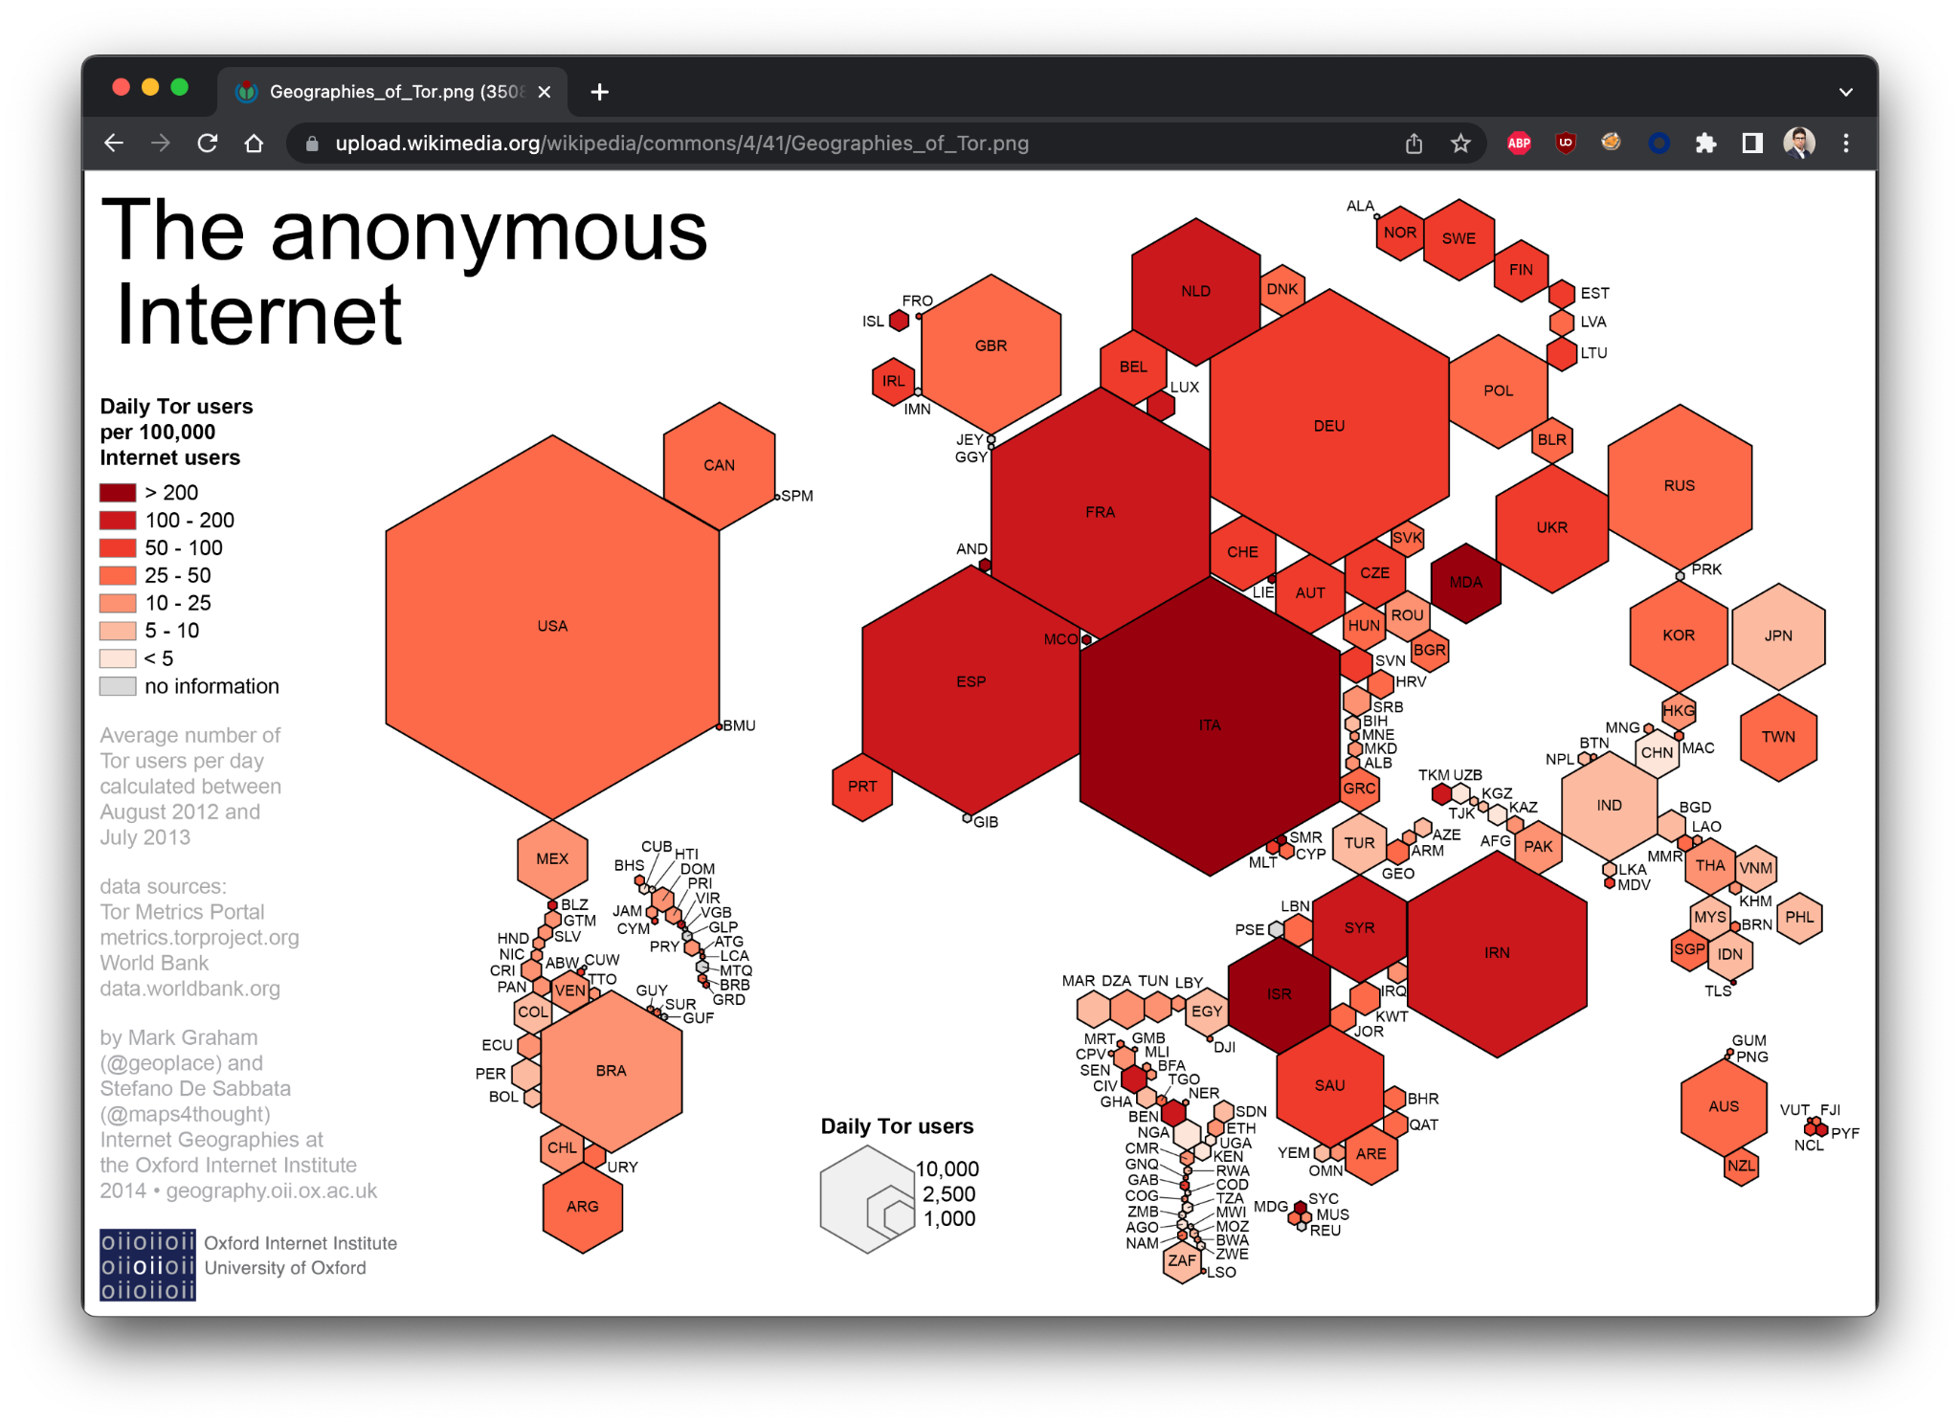
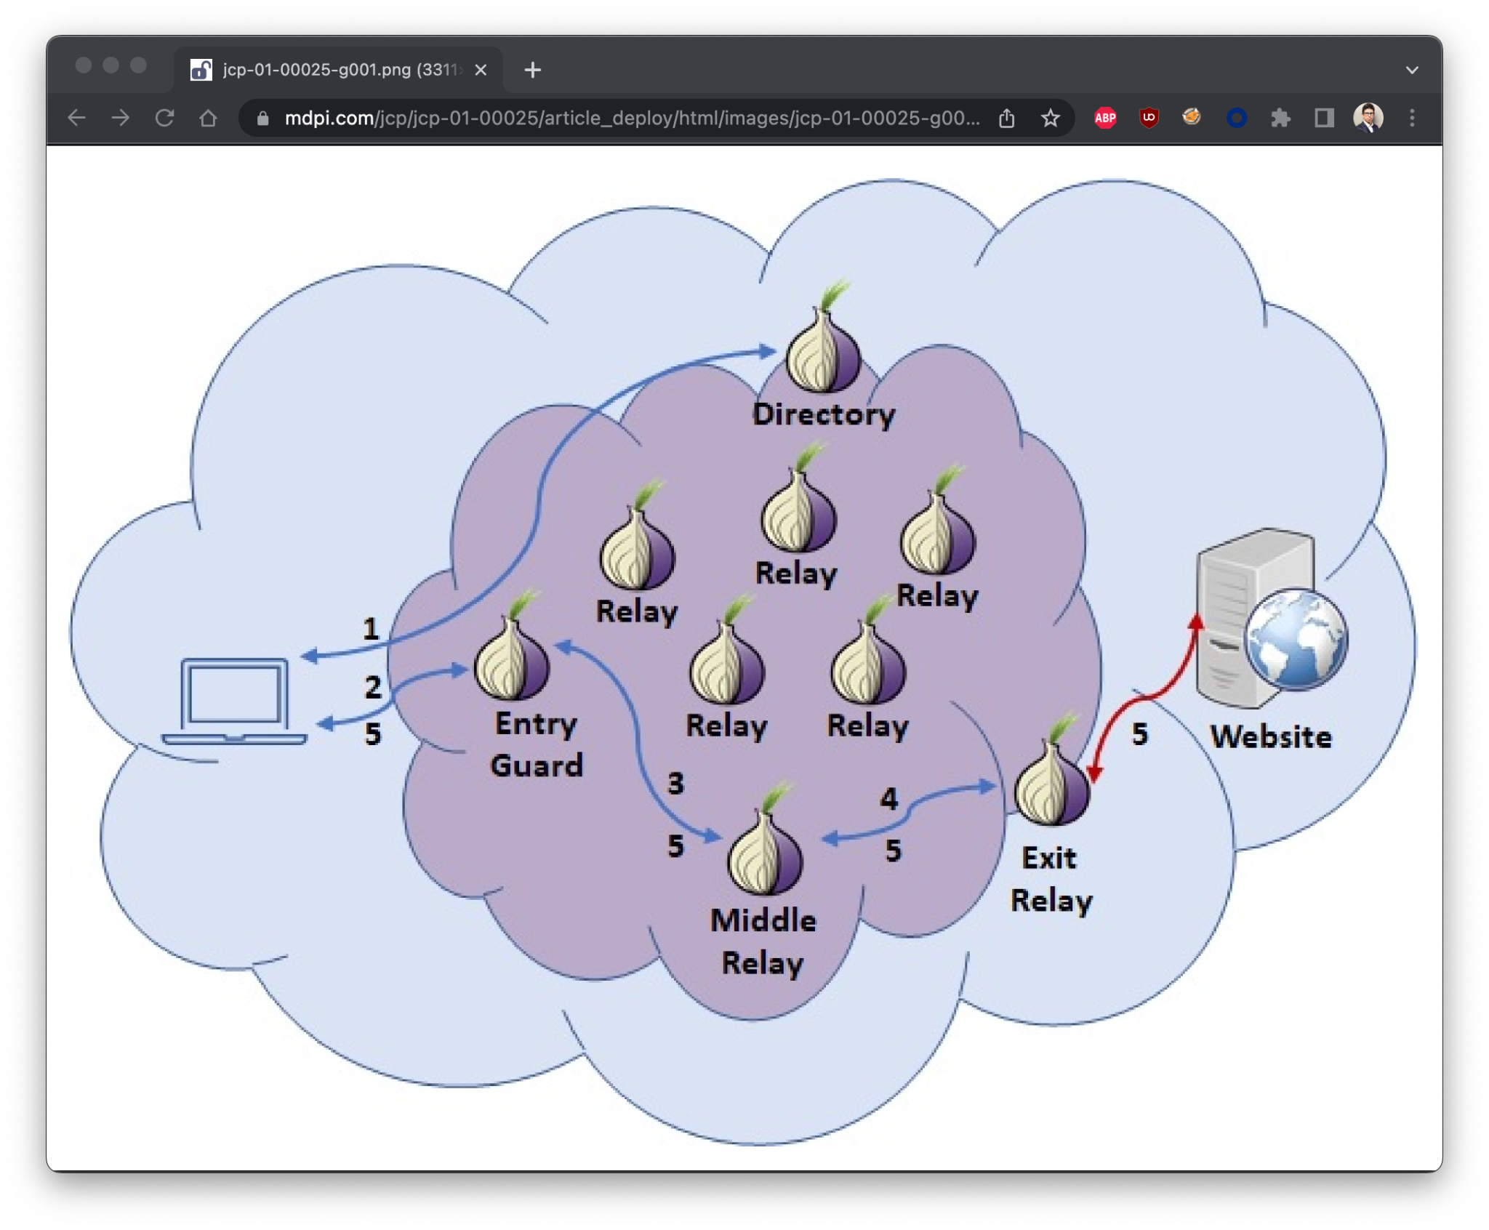
QUICK ON TOR
Notes:
SLIDES WILL BE SHARED AFTER THIS TALK, INCLUDING SPEAKER’S NOTES (BTW A BIG SHOUT OUT TO BLABLA FOR SUPPORTING THE IDEA OF THIS BLABLABLA AND TO BLABLABLABLA FOR HIS/HER HELP IN SETTING IT UP!)
EARLY WARNING: HOPE YOU ALL HAVE NOTHING AGAINST MEME’S…
LASTLY, LET’S KEEP THIS INTERACTIVE! DON’T WAIT FOR THE END TO ASK QUESTIONS

Slide 6
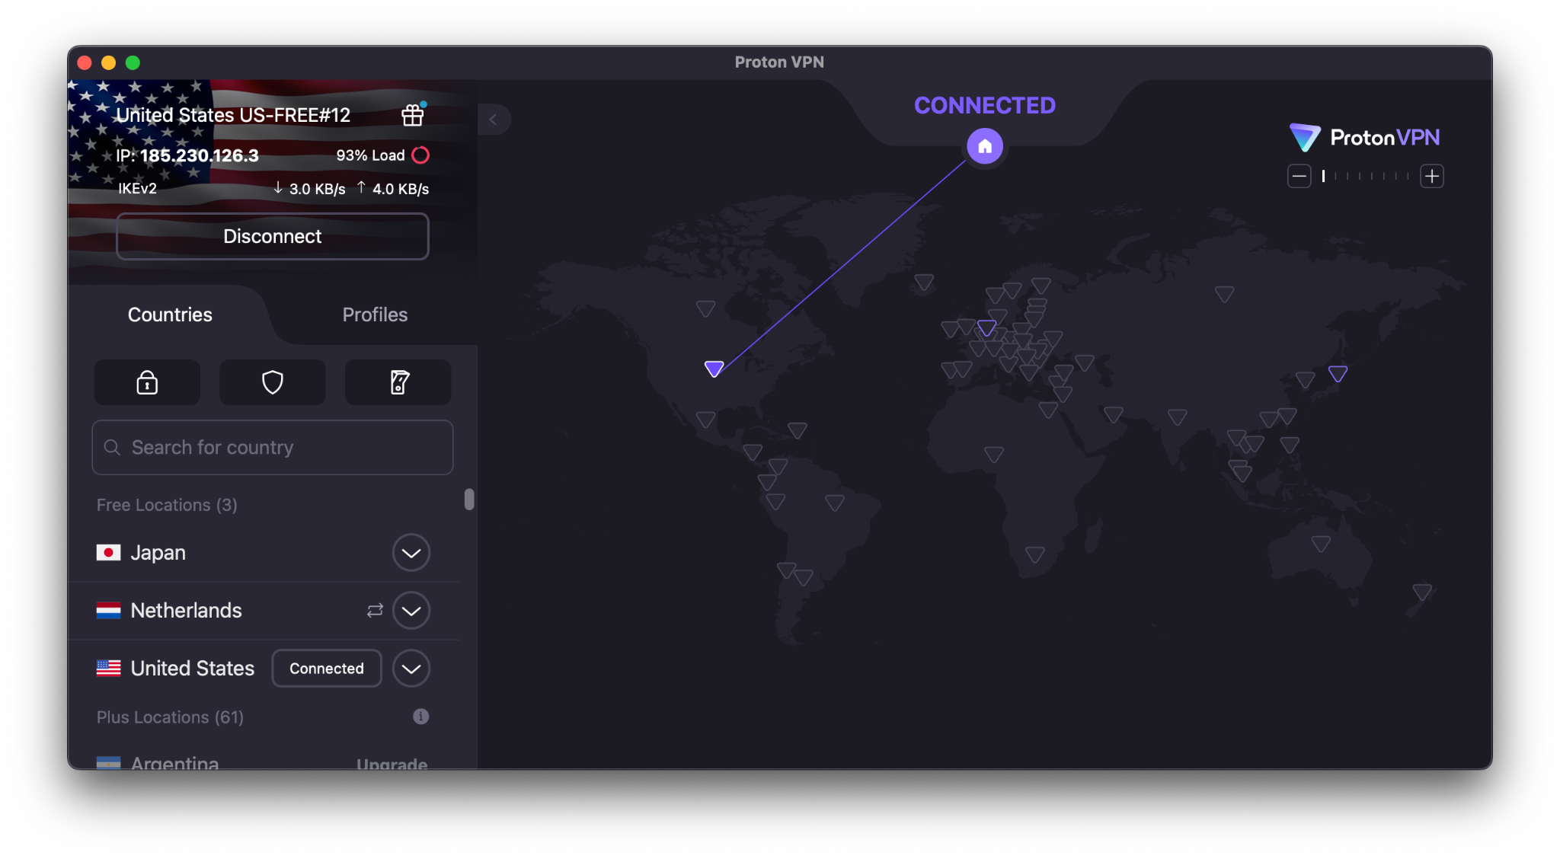
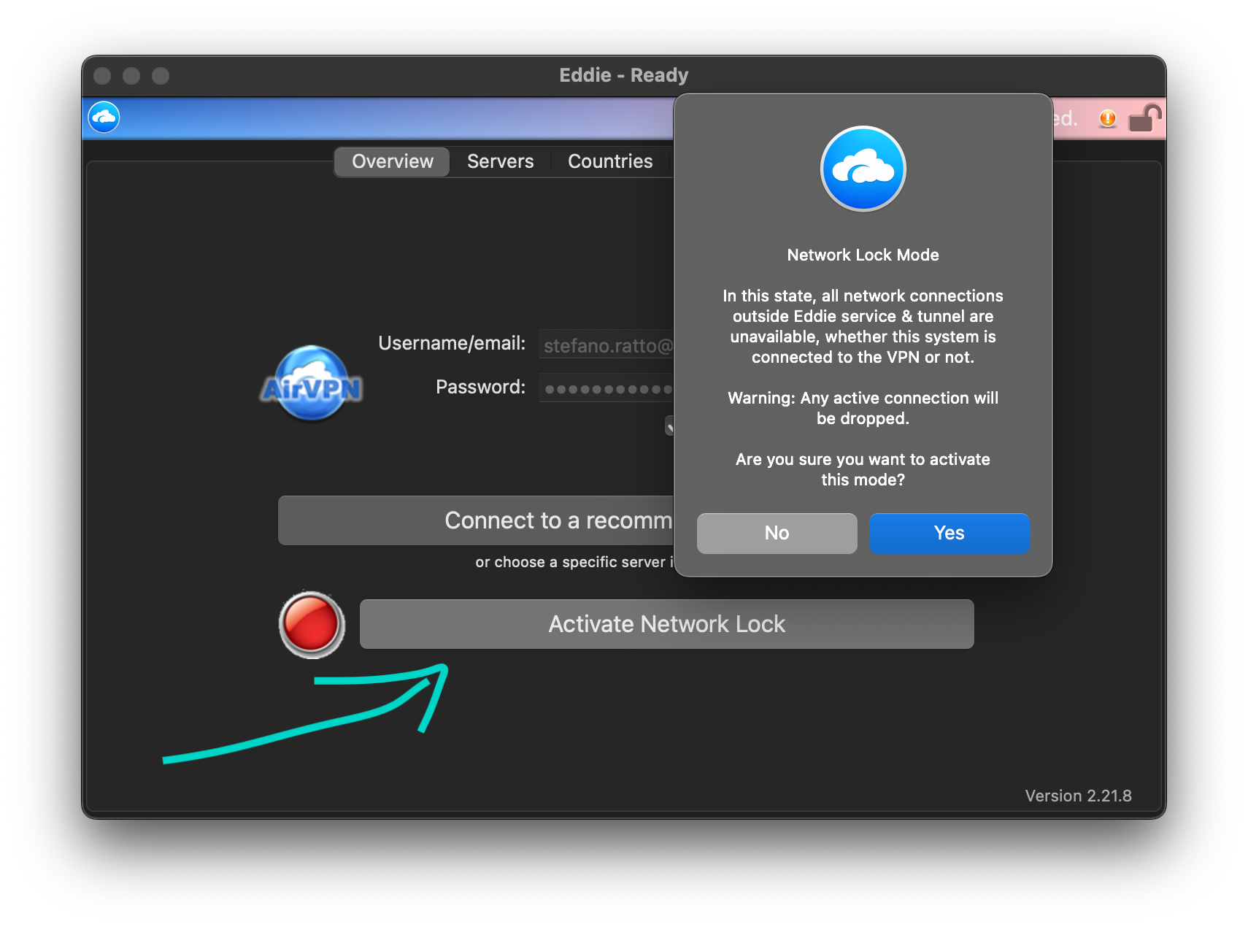
QUICK ON VPNS
Better safe than sorry…
Serious implications
Intention means nothing
Not all VPNs support Tor
ProtonVPN - https[://]www[.]protonvpn[.]com
AirVPN - https[://]www[.]airvpn[.]org
Network Lock for the W!
Mission Critical
M I S S I O N C R I T I C A L
Notes:
SLIDES WILL BE SHARED AFTER THIS TALK, INCLUDING SPEAKER’S NOTES (BTW A BIG SHOUT OUT TO BLABLA FOR SUPPORTING THE IDEA OF THIS BLABLABLA AND TO BLABLABLABLA FOR HIS/HER HELP IN SETTING IT UP!)
EARLY WARNING: HOPE YOU ALL HAVE NOTHING AGAINST MEME’S…
LASTLY, LET’S KEEP THIS INTERACTIVE! DON’T WAIT FOR THE END TO ASK QUESTIONS

Slide 7
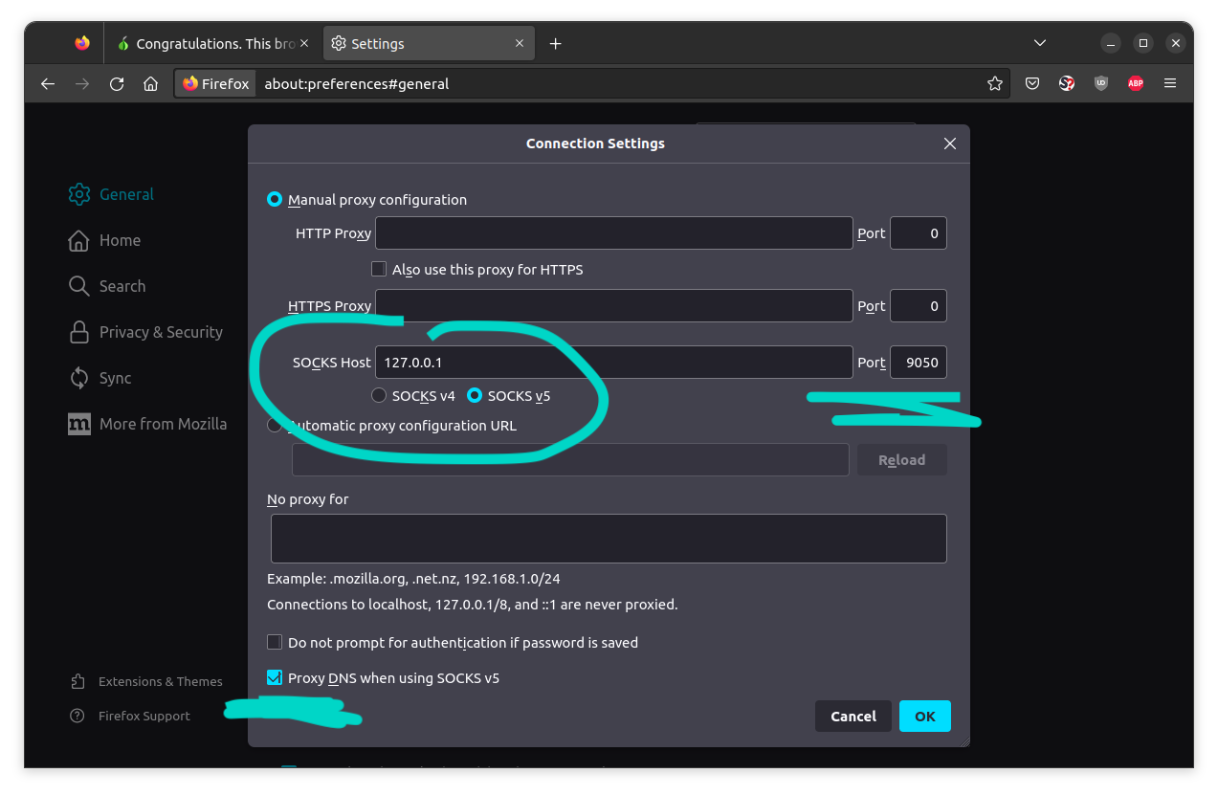
RESOURCES (TOOLS)
Turnkey Browser Setup:
Official Tor Browser - from the Tor Project themselves, Firefox-based
https[://]www[.]torproject[.]org/download/
Custom Browser Setup:
Any browser
Install Tor on OS
Disable Javascript
Proxy ALL traffic (including DNS!!) thru Tor
Entire OS (virtual or physical):
Tails - https[://]tails[.]boum[.]org
QubesOS - https[://]www[.]qubes-os[.]org
Whonix - https[://]www[.]whonix[.]org
Notes:
SLIDES WILL BE SHARED AFTER THIS TALK, INCLUDING SPEAKER’S NOTES (BTW A BIG SHOUT OUT TO BLABLA FOR SUPPORTING THE IDEA OF THIS BLABLABLA AND TO BLABLABLABLA FOR HIS/HER HELP IN SETTING IT UP!)
EARLY WARNING: HOPE YOU ALL HAVE NOTHING AGAINST MEME’S…
LASTLY, LET’S KEEP THIS INTERACTIVE! DON’T WAIT FOR THE END TO ASK QUESTIONS

Slide 8
RESOURCES (PLACES)
TOR.TAXI:
https[://]tor[.]taxi
http[://]tortaxi7axhn2fv4j475a6blv7vwjtpieokolfnojwvkhsnj7sgctkqd[.]onion
DARK.FAIL:
https[://]dark[.]fail
http[://]darkfailenbsdla5mal2mxn2uz66od5vtzd5qozslagrfzachha3f3id[.]onion
AHMIA:
https[://]ahmia[.]fi
http[://]juhanurmihxlp77nkq76byazcldy2hlmovfu2epvl5ankdibsot4csyd[.]onion
Many, many more…
Notes:
SLIDES WILL BE SHARED AFTER THIS TALK, INCLUDING SPEAKER’S NOTES (BTW A BIG SHOUT OUT TO BLABLA FOR SUPPORTING THE IDEA OF THIS BLABLABLA AND TO BLABLABLABLA FOR HIS/HER HELP IN SETTING IT UP!)
EARLY WARNING: HOPE YOU ALL HAVE NOTHING AGAINST MEME’S…
LASTLY, LET’S KEEP THIS INTERACTIVE! DON’T WAIT FOR THE END TO ASK QUESTIONS

Slide 9
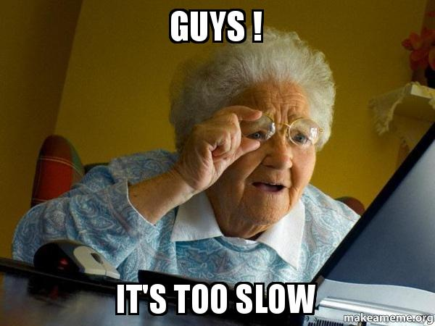
DEMO
Notes:
SLIDES WILL BE SHARED AFTER THIS TALK, INCLUDING SPEAKER’S NOTES (BTW A BIG SHOUT OUT TO BLABLA FOR SUPPORTING THE IDEA OF THIS BLABLABLA AND TO BLABLABLABLA FOR HIS/HER HELP IN SETTING IT UP!)
EARLY WARNING: HOPE YOU ALL HAVE NOTHING AGAINST MEME’S…
LASTLY, LET’S KEEP THIS INTERACTIVE! DON’T WAIT FOR THE END TO ASK QUESTIONS

Slide 10



THANK YOU
STEFANO.RATTO@GMAIL.COM
@STEFANO_RATTO
@STEFANORATTO
Notes:
AND FINALLY, I’D LIKE TO TAKE A MOMENT AND THANK BLABLA AND BLABLABLA FOR BLABLABLABLA AND BLABLABLABLABLA FOR BLABLABLABLABLABLABLA.
THANKS AGAIN AND FEEL FREE TO ASK ME ANY QUESTION.
OTHERWISE, THAT’S ALL, THANK YOU!

